Slide 1


Introduction to Cab Booking
Cab booking is a convenient way to get from point A to point B, whether you're a busy professional or a tourist exploring a new city. With just a few taps on your mobile device, you can request a ride and get where you need to go safely and efficiently.
Prem Krishna (192210064)
Vinod (192211822)

Slide 2
Cab Types and Features
Sedan
SUV
Luxury
Comfortable, classic cars perfect for solo travelers or small groups.
Spacious vehicles ideal for families or groups with lots of luggage.
High-end cars that provide a premium riding experience.

Slide 3

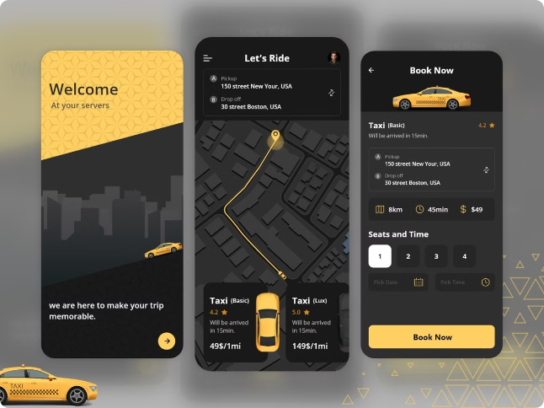
Booking Process
1
Request
Open the website, enter your destination, and request a cab.
2
Match
The website will match you with an available driver in your area.
3
Ride
Your driver will arrive quickly to take you to your destination.

Slide 4

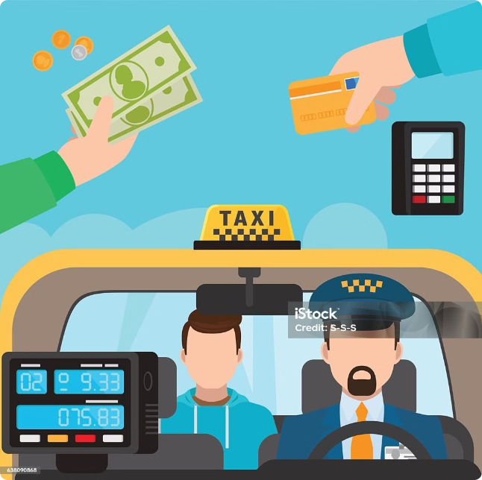
Payment Options
Credit/Debit Card
Mobile Wallet
Convenient and secure way to pay for your ride.
Quick and contactless payment using your smartphone.
Cash
Prepaid Vouchers
For those who prefer traditional payment methods.
Ideal for corporate accounts or frequent travelers.

Slide 5


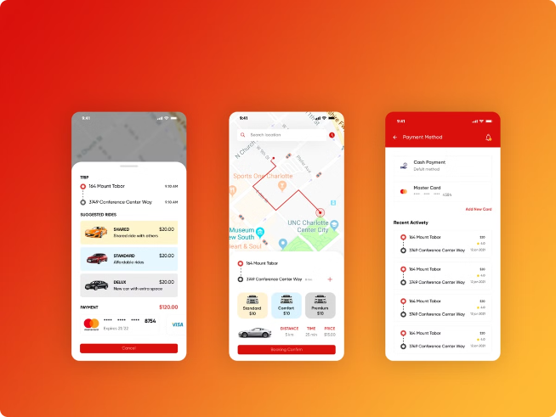


Ride Tracking and Monitoring
Real-Time Tracking
Monitor your cab's location and estimated time of arrival.
Driver Information
View your driver's details, rating, and vehicle information.
Alerts and Notifications
Get updates on your ride status and any delays or changes.

Slide 6





Customer Support
In-App Support
Get assistance with your booking or any issues through the website.
24/7 Helpline
Speak with a live agent for immediate help, day or night.
Feedback and Complaints
Share your experience and address any concerns or problems.

Slide 7


Feedback and Reviews
1
Rate Your Ride
2
Helpful Driver Feedback
Provide a star rating and a brief review of your experience.
Recognize excellent service or suggest areas for improvement.
3
Influence Future Experiences
Your feedback helps us enhance the cab booking experience.

Slide 8

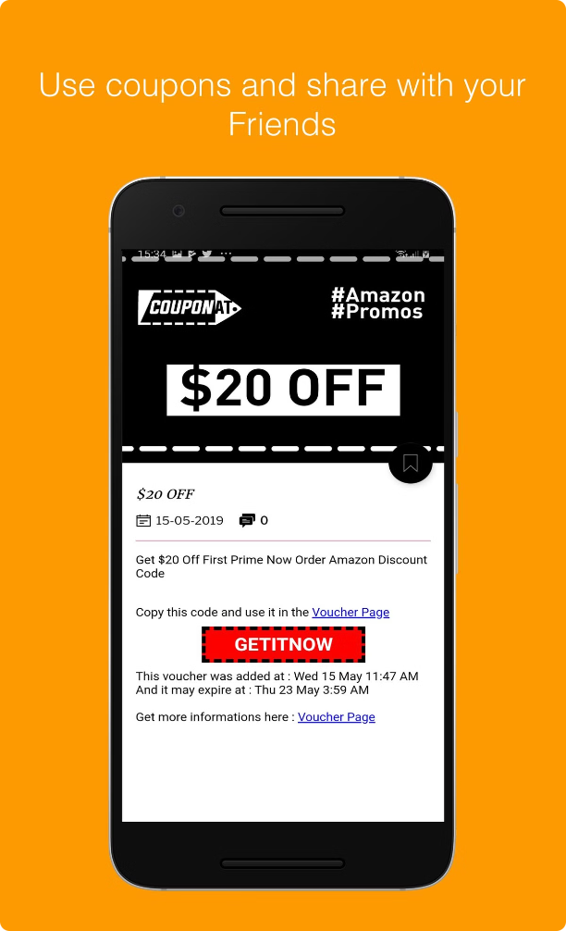
Code
Promo Code
FIRSTRIDE10
Get 10% off your first cab ride
Referral Code
FRIEND20
Earn 200 for each friend you refer
Loyalty Program
REWARDS
Earn points for every ride to redeem rewards

Slide 9

Frequently Asked Questions
1
How do I request a cab?
2
What payment methods are available?
Open the app, enter your destination, and tap "Request Ride".
You can pay with credit/debit card, mobile wallet, cash, or prepaid vouchers.
3
Can I track my ride in real-time?
4
How do I provide feedback?
Yes, you can view your driver's location and estimated time of arrival.
Rate your ride and share your comments in the app after each trip.

Slide 10
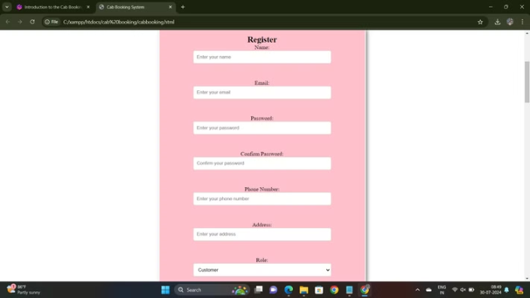

Out put:

Slide 11
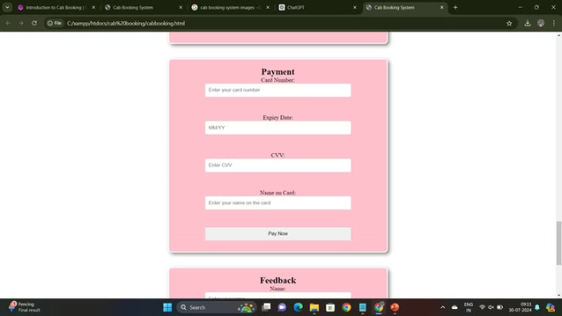
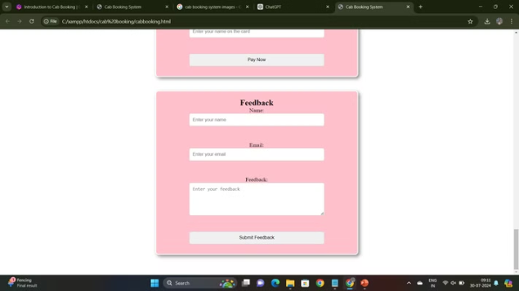

Slide 12

Conclusion
The cab booking system is a essential tool for modern transportation. With its user-friendly features, secure payments, and reliable service, it provides a seamless and convenient way to get around the city. As the demand for on-demand mobility continues to grow, we are committed to enhancing our platform and delivering an exceptional experience for our users.

